Slide 1

Generalized Block
Sponsor: Dr. Jeff Scargle
Supervisor: Dr. Brad Jackson
CAMCOS Director: Dr. Slobodan Simic

Slide 2
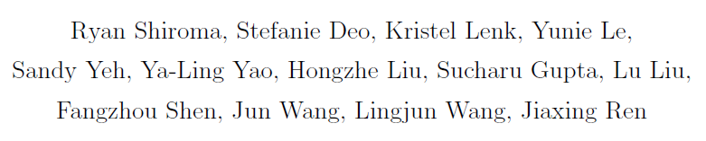



Group Members

Slide 3
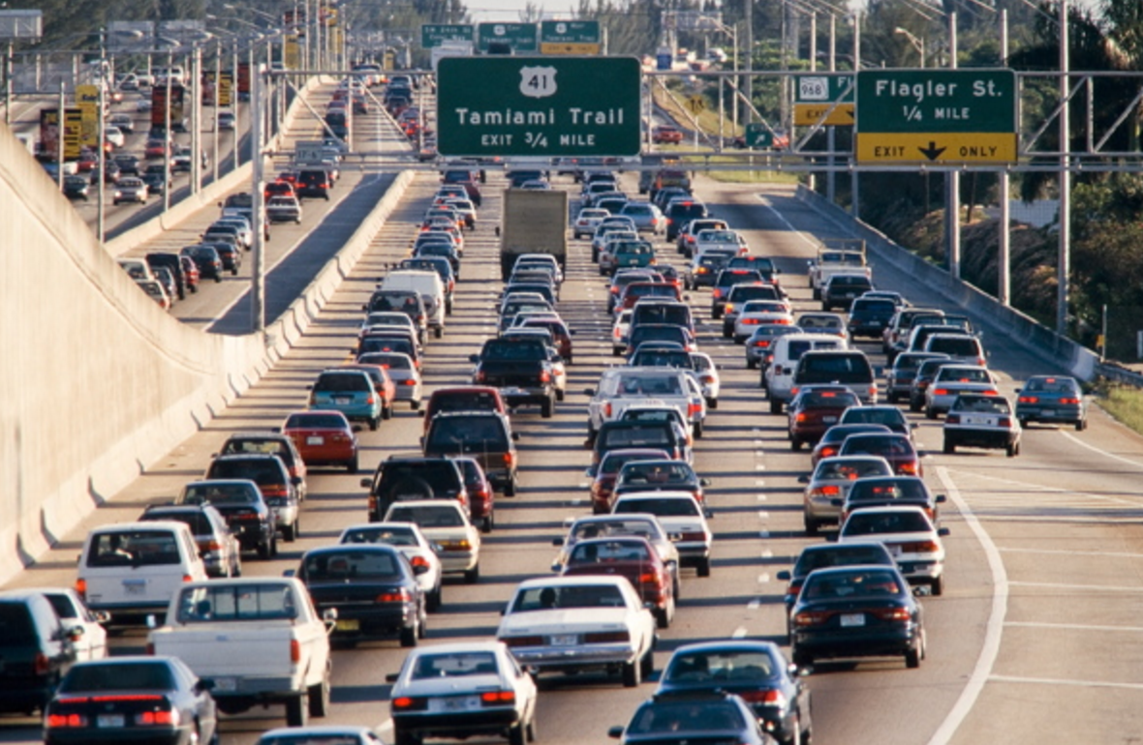

Let’s start with an example
Traffic flow
Non Homogenous Poisson Process
Notes:
So what kind of data we are using? Let’s start with a real world example that we see everyday -- the traffic flow. The left picture showed us what does the traffic flow look like in the peak traffic hours. There are large # of cars traveling on the freeway. Where on the right picture, there are barely no cars which maybe in the non peak hour of the day. The traffic flow data are NHPP data. The reason its a poisson process data is the individual car arrival can be treated as independent events which follows the poisson process property. Also, traffic data are non homogenous b/c the # of car arrival per time unit(15 mins or 30 mins)are changing throughout the day.
The data we are using are generated from NHPP. We are using this since we are tracking the change of brightness of an astronomical object by using photon counting data. Photon counting data follow the property of a poisson distribution. Maybe it is hard to visualize the photon data but let us find a real world example which we can see everyday -- the traffic flow. The traffic flow is a poisson process b/c Individual car arrival can be treated as independent events. Also, traffic data are non homogenous b/c it has changing total counts in car arrivals per 10 mins or per hour, for a specific measuring point. The changing total counts in car per time unit are intensity for the traffic data. Lets see a more detailed illustration next page.

Slide 4
Outline
Introduction
Bayesian Blocks and Extensions to New Shapes
Applications to Real-time Analysis

Slide 5
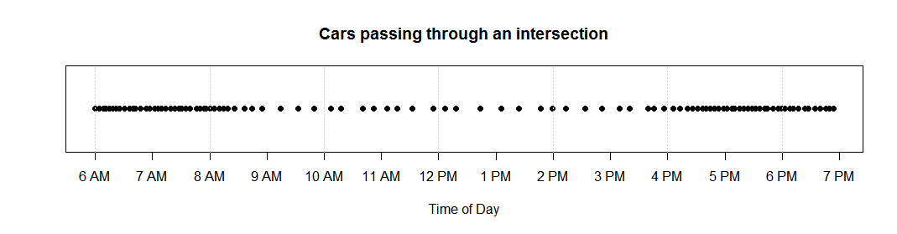
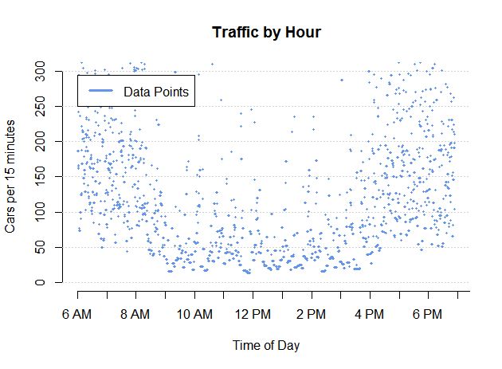
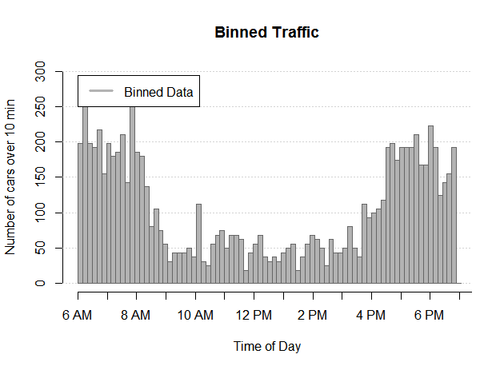
What is Intensity?
Notes:
The general definition for intensity is number of events per time unit. In traffic flow, it means the number of car arrivals per time unit. We can visualize intensity by those pictures. All of the three graphs in here shows us the intensity of cars are changing throughout the day with different illustrations. From the binned traffic plot below we can see around in the morning and afternoon rush hours, the intensity of the traffic flow is large since the vehicle count per 15 min is really high. During the non peak hours, the intensity is pretty low.

Slide 6
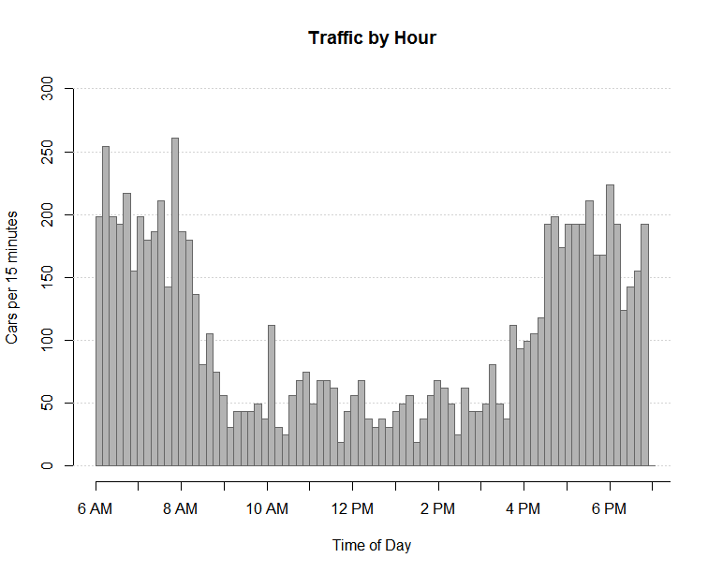
What are Blocks and Changepoints?
Block: a partition of the data with similar intensities
Changepoint: the point of time between two blocks
Notes:
So what are blocks and changepoint? Blocks are partitions of data with similar intensities. Taken the graph from last slide, the data was grouped into three different blocks and the data in each block has similar intensities.
And the changepoint are the point of time btw two blocks. On the graph, the changepoint occurs little bit before 9 am thats when the rush hour ends and another changepoint occurs about 4pm thats the evening rush hour start.

Slide 7
“Blocking” using Probability
The observations inside each block follow a Poisson distribution that are associated with different intensities
Likelihood of the data inside a particular block
Notes:
1. Let’s take a look at the pic on the left side, we can see that the whole-time interval has been separated into 3 blocks and each block is associated with different intensity. The intensity of the first block is around 200. As Linjun mentioned before, the #observations in a particular block follows the property of Poisson distribution. So, given a block and intensity, we are able to calculate the likelihood of observing the current data inside that block. This lead us to the notation of cost function

Slide 8
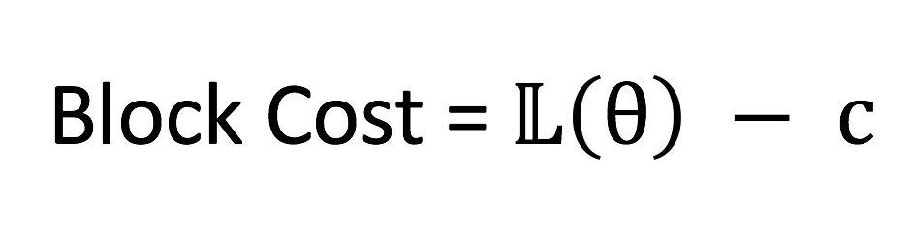
Cost Function
L: the likelihood function that shows how likely theta is to occur with the data
c: the penalty for each additional block
Notes:
2. What is cost function? This is the general formula of Cost function. The L function is the likelihood of the current data and c is the penalty for each additional block
So, the cost function is just the same as the likelihood of observing the current data. It can be used as a measure of how well an intensity is fit to the data in a block. It takes in different candidate intensities and outputs a cost value that summaries how likely the current data would occur under that particular candidate intensity. And the intensity that gives the highest block cost would be the most possible one that generate the observations. Now, let’s see an example that illustrating how to apply the cost function to select the best partition for a time interval

Slide 9
Example
5
1
3
1
2
1
4
2
Partition 1
Partition 2
Partition 3
Partition 4
Notes:
3. In this example, we observe 3 data points in a time interval. Then there would be four possible partitions to form the blocks. One way is to group the 3 data points as one whole block. Another way is to group the 1st data point as a block and the rest two as another block, etc. And notice that each block is associated with a block cost, which is calculated by the cost function.
The cost of a partition is the sum of all block cost in that partition. For example, the total block cost of the 3rd partition is 5. In our example, among all the 4 possible partitions, we pick the one with the largest total block cost.

Slide 10
Example
5
1
3
1
2
1
4
2
5
Partition 1
Partition 2
Partition 3
Partition 4
Notes:
4. Which is the last one. And we could see that the blocks in our last pic comply with the true intensity function.

Slide 11
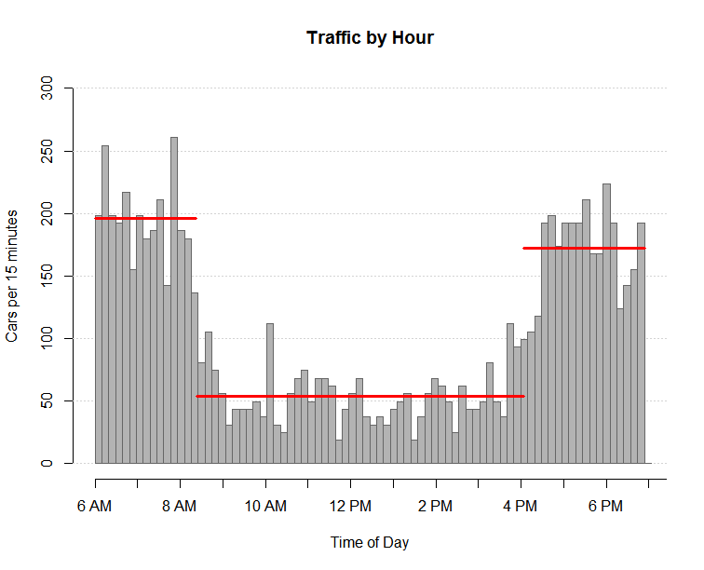
The Bayesian Blocks Algorithm
Dynamic programming: allows us to find optimal partitions without needing to test all possible partitionings
Constant Intensity Blocks
Notes:
Alen will finish with partitions. I will start with partition in bayesian blocks algorithm that Dr. Scalge has.
Main idea of constant blocks

Slide 12
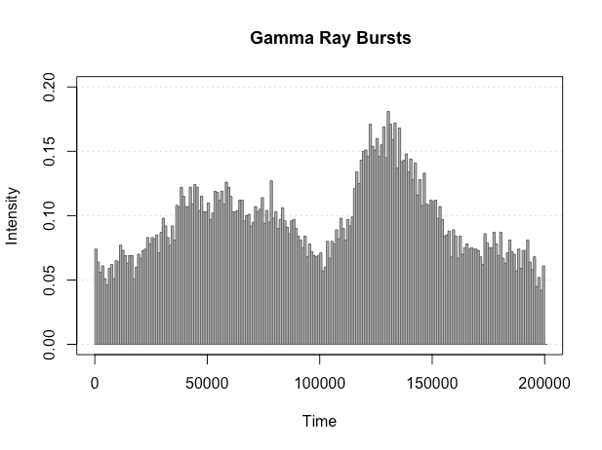

Why are we doing Bayesian Blocks?
Gamma Ray Bursts
Left Picture Credit: NASA/Swift/Cruz deWilde
Notes:
What is it about gamma ray
What are we going to apply to gamma ray bursts.
Background noise, gamma ray bursts, background noise

Slide 13
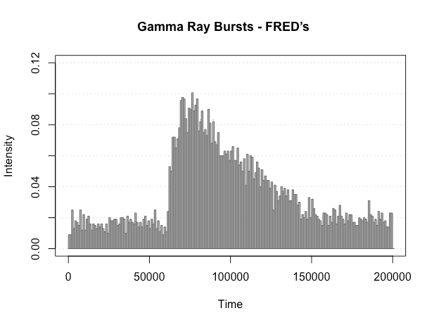
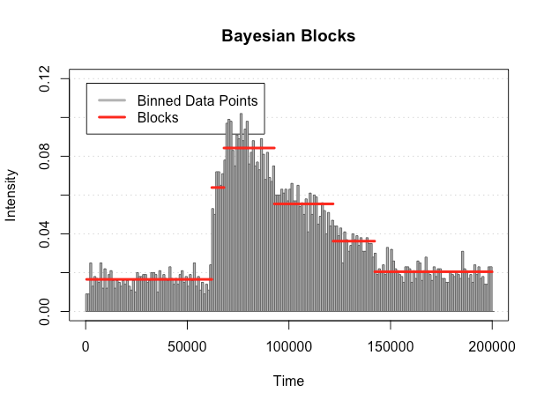
Project Goal: Model FREDs
Notes:
Fast rise exponential decay (first or second week) (talk about why we care about shapes)

Slide 14
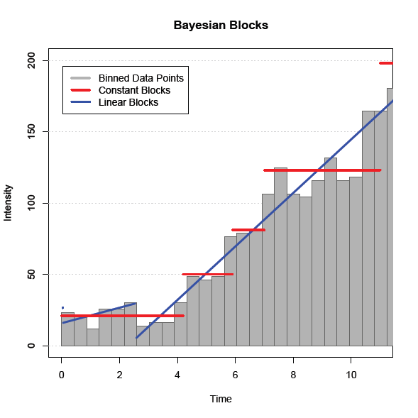
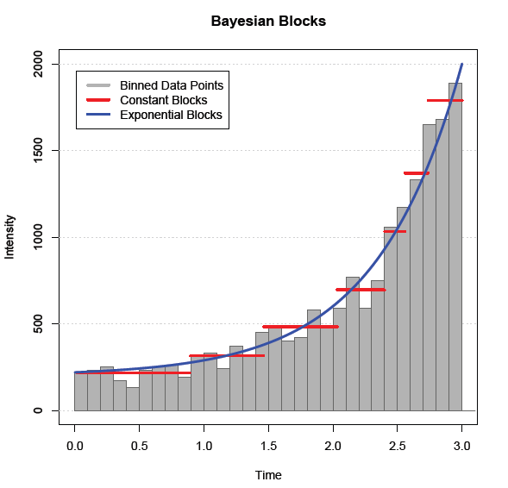
Extension to non-constant blocks

Slide 15
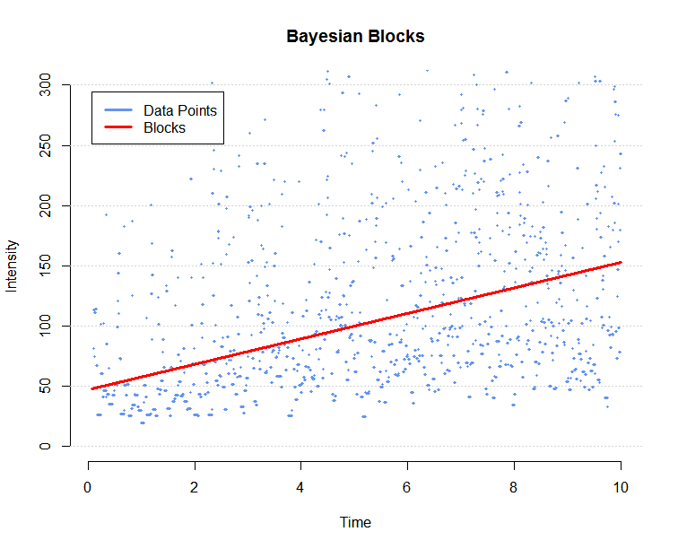
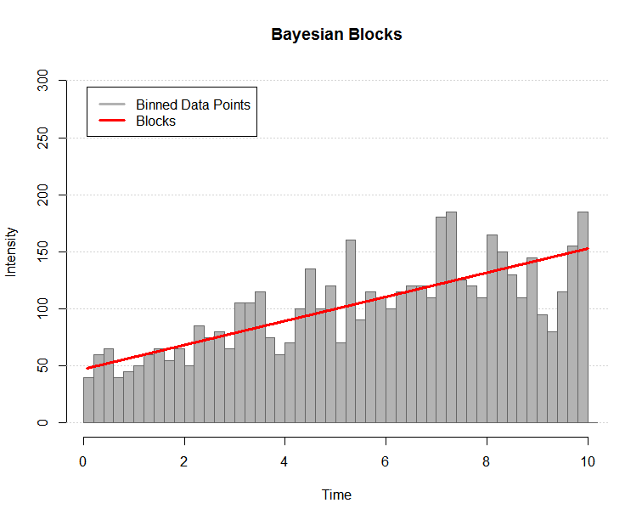
We’ve derived two methods to fit the data
Unbinned
Binned

Slide 16
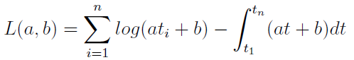
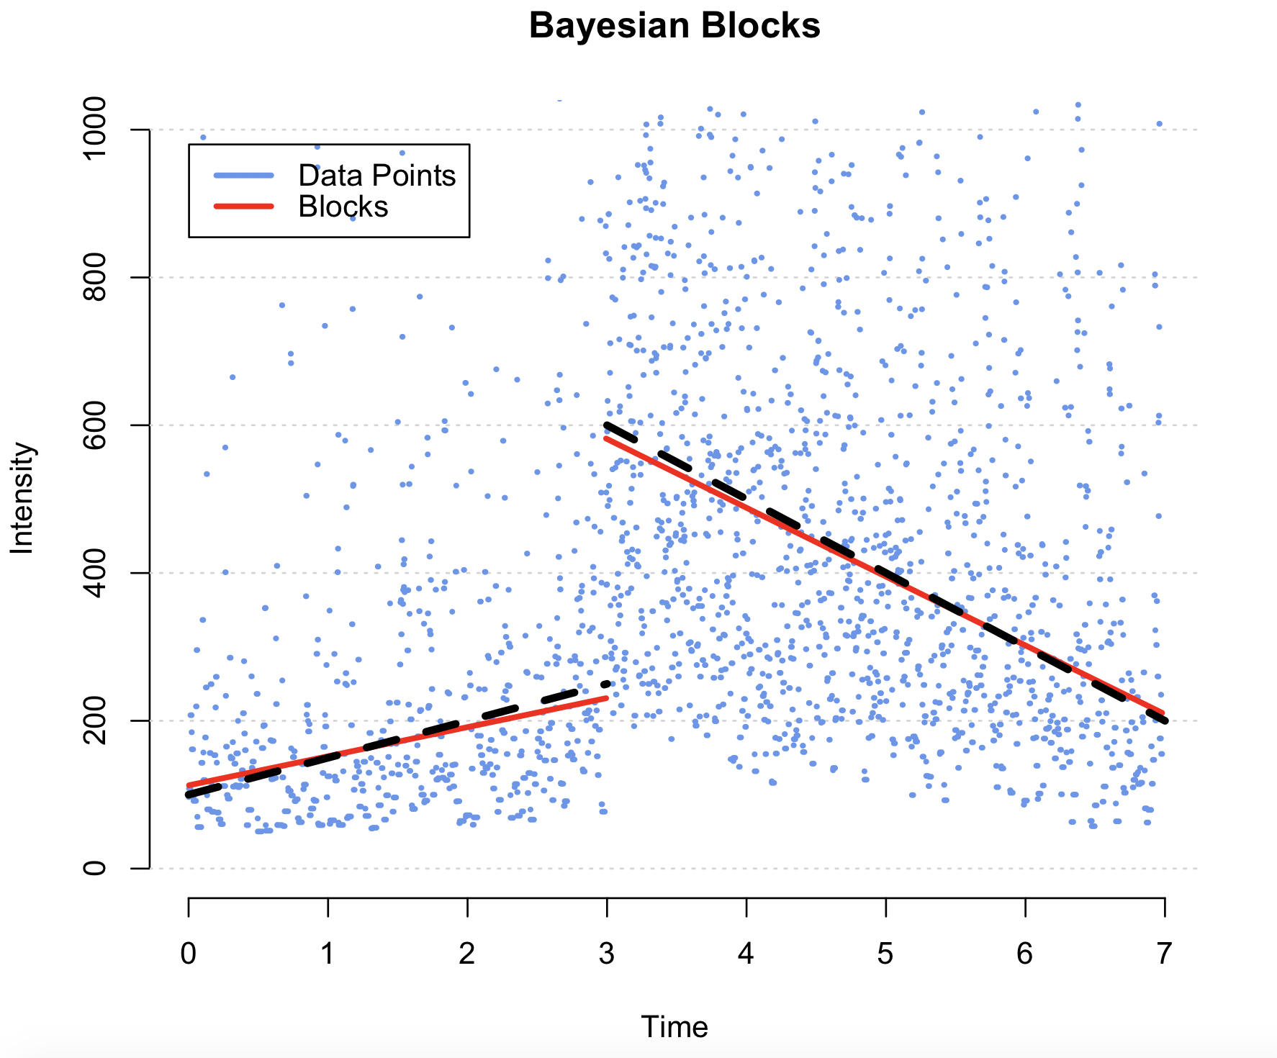
Unbinned: Piecewise Linear Model
Newton's method is used to solve for the converged values of the maximum likelihood estimates of a and b.

Slide 17
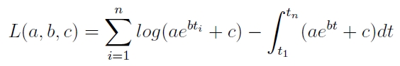
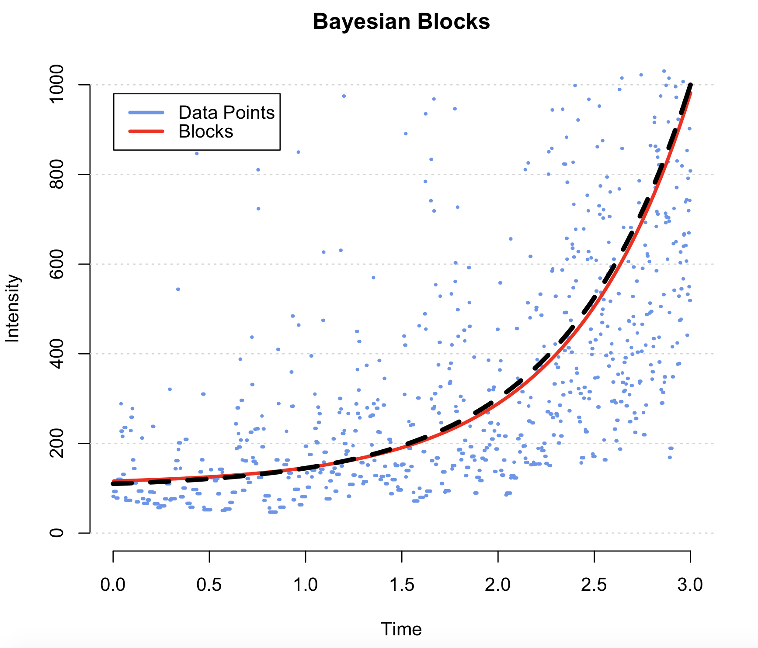
Unbinned: Piecewise Exponential Model
Newton's method is used to solve for the converged values of the maximum likelihood estimates of a, b, and c.

Slide 18
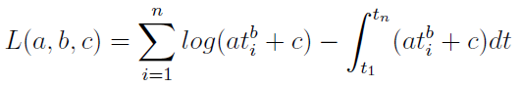
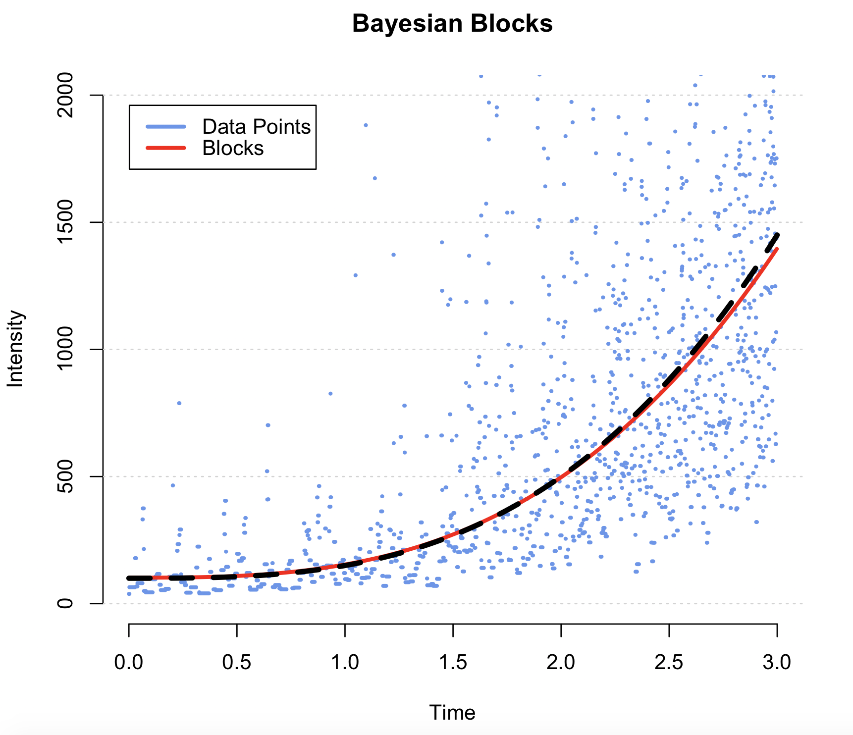
Unbinned: Piecewise Power Model
Newton's method is used to solve for the converged values of the maximum likelihood estimates of a, b, and c.

Slide 19
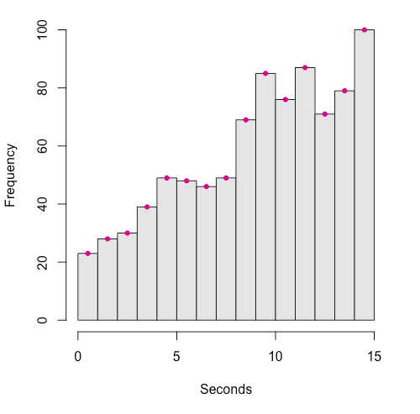
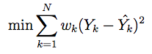
Binned Data
Approach:
Group data into equal length blocks.
Count the points in each bin (Yk).
Record the midpoint of each bin.
Fit a model using iterated weighted least squares:
Notes:
Number of bins increases with sample size.

Slide 20
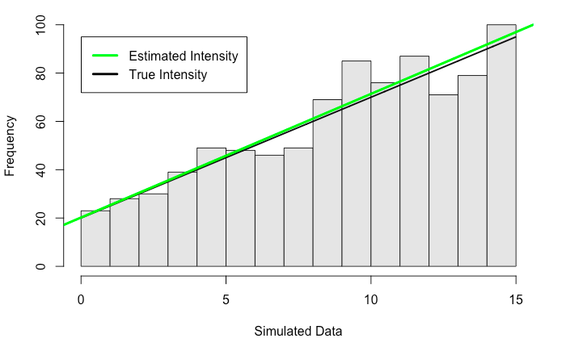
Linear Intensity

Slide 21
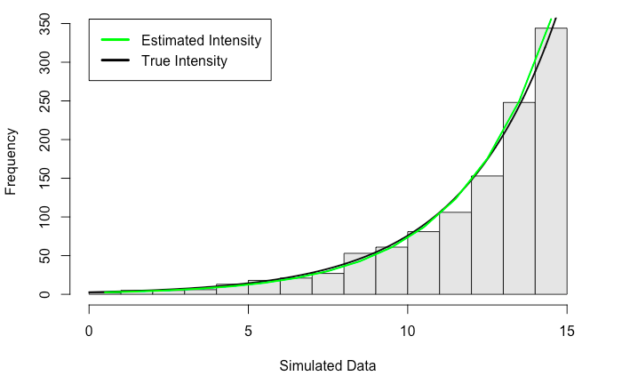
Exponential Intensity

Slide 22
How Do the Two Methods Compare?
?

Slide 23
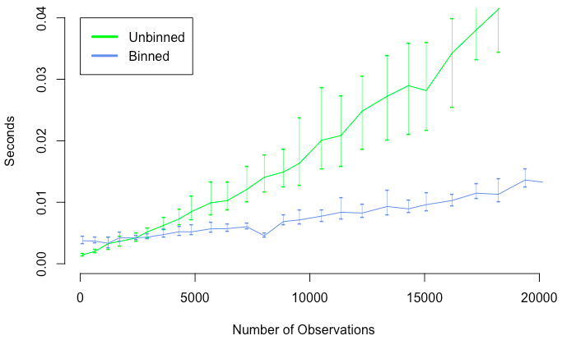
Comparing Speed
Notes:
We are estimating the time it takes to find the slope and intercept at each sample size. True slope and intercept remain the same while sample size increases.
It can probably also be smoothed by running this test >50 times then averaging the times. - agreed, and updated the plot with 50 iterations at each sample size

Slide 24
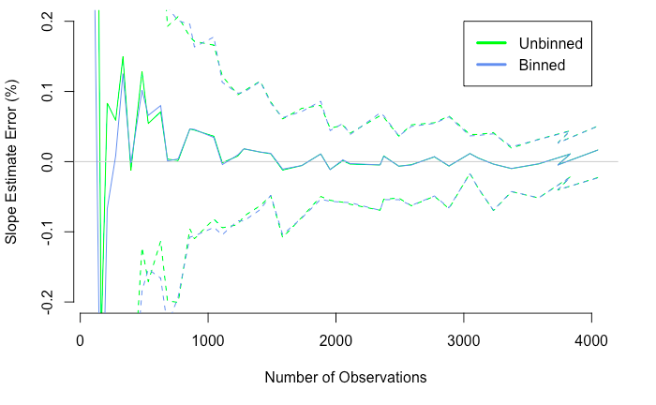
Comparing Slope Estimates

Slide 25
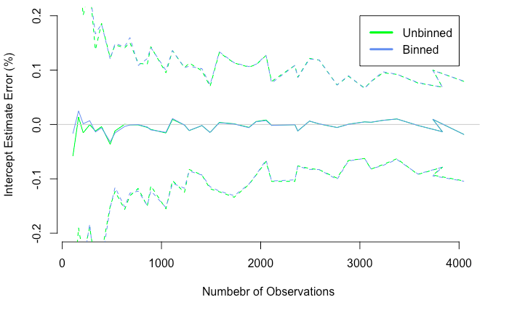
Comparing Intercept Estimates

Slide 26
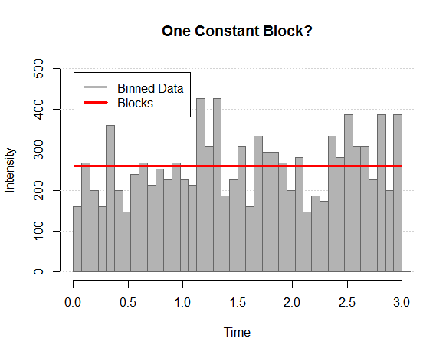
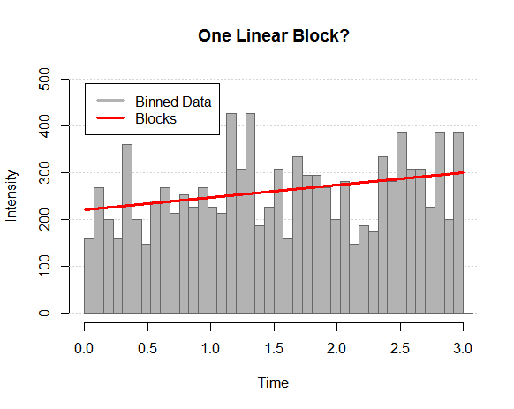
How do we select between different shapes?
??

Slide 27
How do we select between different shapes?
Likelihood Ratio Test
Null Hypothesis: A constant block is sufficient
Alternative Hypothesis: Reject constant block (use linear shape)

Slide 28
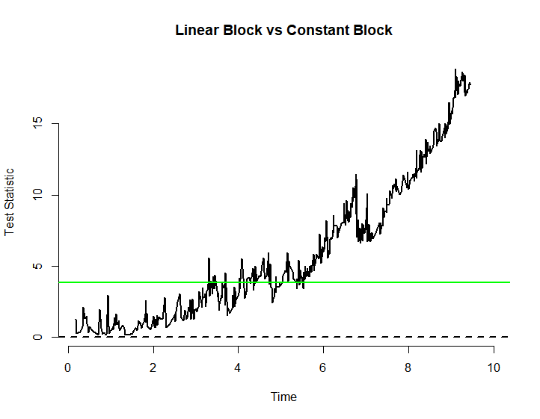
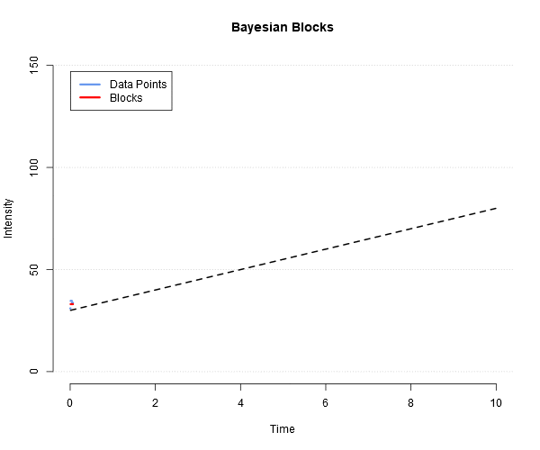
How do we select between different shapes?

Slide 29
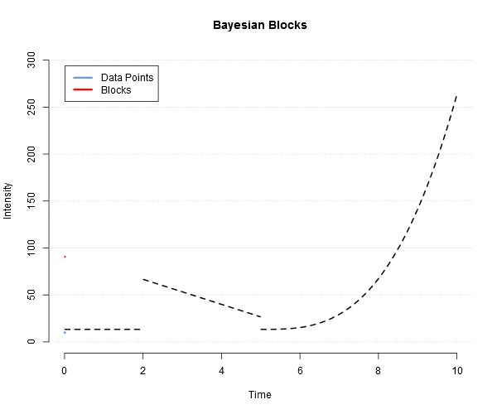
Results - Simulated Data

Slide 30
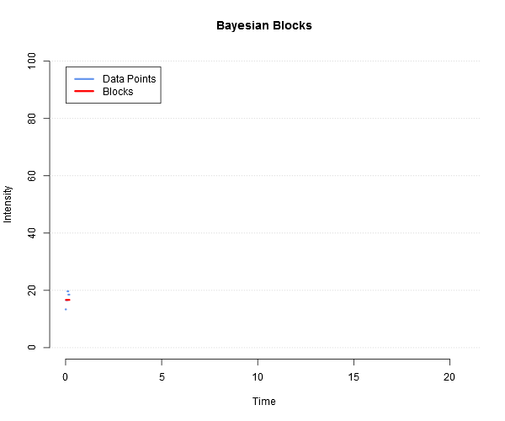
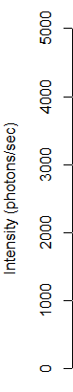
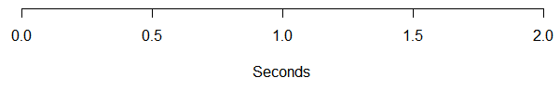
Results - BATSE Trigger 551 (Constant)
Notes:
BATSE - BATSE is an instrument that detects gamma-ray bursts by examining the count rates of each of the attached eight detectors. Here our data comprises of 10,000 photons from BATSE GRBs. Here are the plots of fitting constant and linear blocks.
Time scale fixed.
All three of these plots correspond to gamma ray burst trigger number 551

Slide 31
Results - BATSE Trigger 551 (Constant + Linear)
Notes:
BATSE - BATSE is an instrument that detects gamma-ray bursts by examining the count rates of each of the attached eight detectors. Here our data comprises of 10,000 photons from BATSE GRBs. Here are the plots of fitting constant and linear blocks.

Slide 32
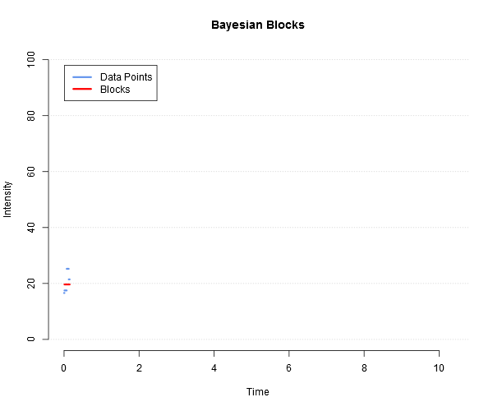
Results - BATSE Trigger 551 (Constant + Lin + Exp)
Notes:
BATSE - BATSE is an instrument that detects gamma-ray bursts by examining the count rates of each of the attached eight detectors. Here our data comprises of 10,000 photons from BATSE GRBs. Here are the plots of fitting constant and linear blocks.

Slide 33




Slide 34
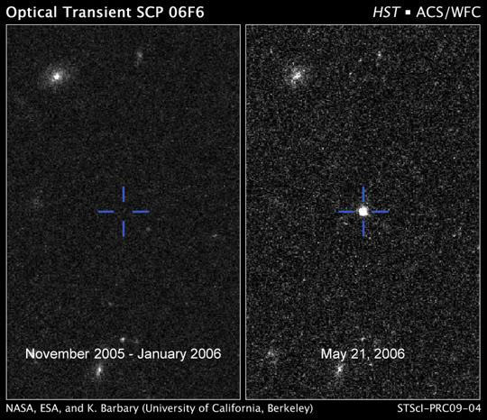
Applications to Real-time analysis
In many cases, it is fine to analyze historical data that has already been collected in the past
However, in other cases, researchers are interested in detecting activity in real time
A classic example is the detection of “transients”: an object that was previously invisible and suddenly brightens, e.g. a supernova.
Image credit:
https://www.nasa.gov/mission_pages/hubble/science/hst_img_20090106.html
Notes:
[Lu]
Now we’ll talk about the applications of the Bayesian Block algorithm to real-time analysis. In many cases, it is fine to analyze existing data, or data that has already been collected in the past. However, in other cases, researchers are interested in detecting activity in real time. For example, in astronomy a scientist may often observe a part of the sky which is a "blank field" where there is no object of obvious interest. The scientist may be interested in detecting a "transient", which is an object that was previously invisible and suddenly brightens, such as a supernova. Here on this slide is a picture of such a transient, a cosmic flash which was first detected by NASA’s Hubble telescope on February 26, 2006. It steadily rose in brightness for 100 days, and then dimmed back to oblivion after another 100 days.
Image credit:
https://www.nasa.gov/mission_pages/hubble/science/hst_img_20090106.html
Question for Dr. Scargle:
Can real-time detection enable researchers to devote more resources to investigating a certain event? (Confirm with Dr. Scargle; I vaguely remember something about turning a special telescope to a part of the sky when activity is detected in that part.)

Slide 35
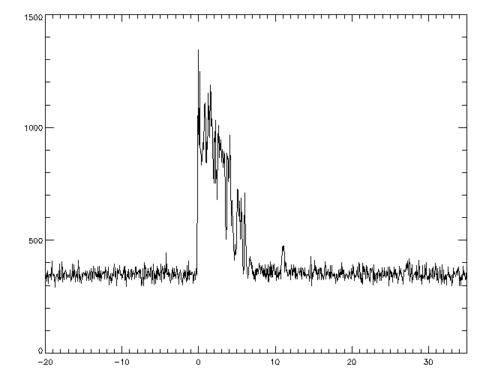
Notes:
[Lu]
The left picture is of a blank field, and for this we would expect only noise in our intensity data as shown in the left area of the plot below. When the transient appears, the signal might look something like the burst of intensity as shown in the middle of the plot.

Slide 36
Bayesian Block Triggers vs Thresholding Triggers
Thresholding
The current method of detecting transients is by setting a threshold value.
When the mean signal in the latest window rises above the pre-set threshold, a transient detection is declared
Problem: the threshold p needs to be pre-set, along with a window w length over which an average is drawn
Sliding window that is compared against left window
Left window (noise)
Notes:
[Lu]
The current method of detecting transients is by setting a threshold value. There is usually a low, but steady, incoming signal stream which is just noise. The idea is that when the incoming signal rises above the threshold, a transient detection is declared. The problem is that the threshold needs to be pre-set, and typically its value is determined based on some time-averaging of the data. One also needs to specify a window of time over which an average is drawn. The idea here is that we have a left window (the green one), and we have another window (the red one) that “slides” to the right whenever new data comes in. The average of the current sliding window is compared to the green window. So, since there are 2 parameters that need to be chosen, the threshold method can be quite sensitive. Some aspects of this problem can be avoided by adopting several different thresholds, but this can be problematic.

Slide 37
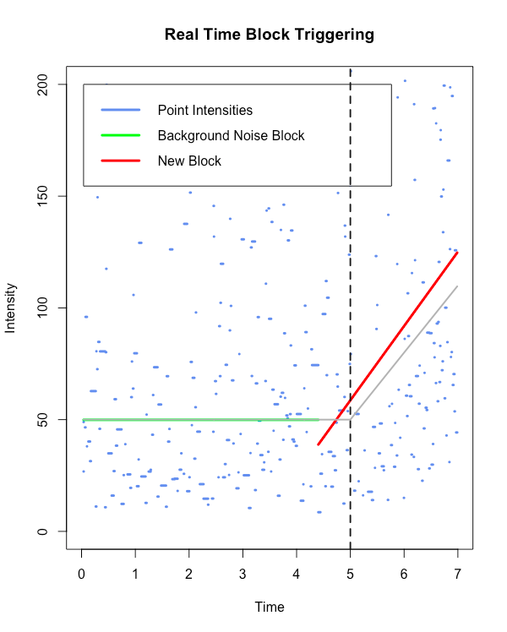
Bayesian Block Triggers vs Thresholding Triggers
Bayesian Block algorithm
When a new data point is added, the algorithm is called.
If the algorithm determines that the best fit is still one constant block, no transient detection is declared
BUT if the algorithm determines that the best fit is a new (second) block, then a transient detection is declared
Needs only 1 parameter: c
Notes:
[Lu]
By contrast, the Bayesian Block algorithm does not rely on any pre-set threshold or pre-set window. This makes it ideal for transient detection. When every new data comes in, the algorithm would recompute it. If the algorithm determines that the intensity does not change a lot and best fit is still one constant block, no change point is detected. But if the algorithm determines the intensity change a lot and the best fit is a new block, then a change point is declared.
So here on this slide,the green line: the first block, is the best fit block for the background noise.At around the 5th second, algo finds the intensity had shifted, and the red line is the best guess for the second block, it’s a linear block.

Slide 38
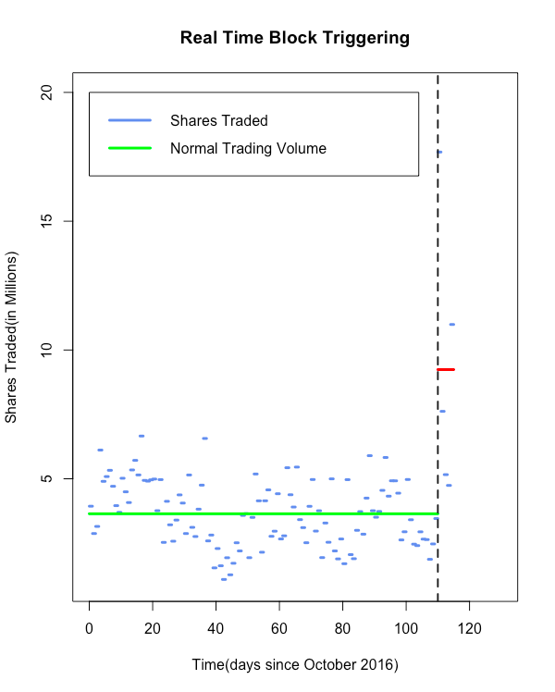
Comparing Bayesian Blocks and Thresholding
If we know the true change-point:
Accuracy - the closeness between the estimated change-point to the true change-point.
Reaction time - “distance” from the true change-point to the triggering point.
Note: Instead of measuring the time period, we used the number of points that occurred in between.
Notes:
[Jiaxing]
So, theoretically that the Bayesian Block algorithm is ideal for transient detection. But is it really better in practice compared to thresholding? Our goal is to find out. In order to compare the two, we needed ways to measure how effective each method was. For data where we know the true changepoint, we have two metrics: accuracy and reaction time. Accuracy would be how close the estimated changepoint to the true changepoint is. So for example, in the plot here, the accuracy is very good since the two blocks separated right where the dashed line, the true changepoint, is. Then, the second metric, reaction time, would be the distance from the trigger point which the algorithm been warned that a change had taken place to the true changepoint. So here, it would be the distance from the dashed line to the purple line. Another thing we need to clarify here is when we measuring the “distance”, we’ll not adopt time period as our units, but use the number of points that occurred in between. Because the frequency of points can vary widely for different datasets, e.g. for one dataset, a point can come approximately every 2 seconds, while for another, it could be every few milliseconds.
We compare the Bayesian block and thresholding algorithms from two constant blocks. First, we illustrate the definition.
True CP is the true changepoint as specified in our simulated data.
Detected CP is the algorithm's best guess on where the changepoint is.
TriggerPoint is the point at which the algorithm detected that a changepoint had taken place.
In this case, Thresholding is detecting the changepoint sooner (at 278 vs 302). However as you can imagine, changing the value of c (to a higher or lower number) for the thresholding algorithm will make it perform very differently.

Slide 39
Compare BB and Threshold by Accuracy
How to find a “fair” c for the BB algorithm? And p,w for the Threshold algorithm?
Randomly select 20 simulated datasets with same pattern.
Analyse parameters (c in BB, p,w in Threshold), find the best values in a big range that maximize the Accuracy for each datasets .
Average those values and set it to be our “best guess”.
Use those “best guess” of parameters in each algorithm, test other 5 simulated datasets which holds same pattern (with 5 replications).
Accuracy = 1
| Estimated changepoint - True changepoint |
Notes:
Now, we have the metrics, but how about the parameters?
Well, here is the procedure of how we constructed the comparison.
For accuracy we defined it as ...
Same pattern: for example all from lower density suddenly change to a higher density (over about 2 times higher)

Slide 40
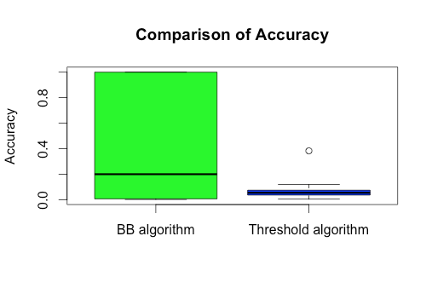
BB is more accurate on average
Pattern: from lower density to higher density.
Select c from 100 values that uniformly in a range of (1,200).
Select w from 10 values that uniformly in a range of (1,100).
Select p from 10 values that uniformly in a range of (0.1,0.9).
Apply our “best guess” to 5 new data sets with 5 replications.

Slide 41
Compare BB and Threshold by Reaction Time
Randomly select 20 simulated datasets that have the same pattern.
Analyse parameters (c in BB, p,w in Threshold), find the best values in each dataset that minimize the reaction time.
Average those values and set it be the “best guess”.
Use those “best guess” of parameters in each algorithm, test other 5 simulated datasets which hold same pattern with.
Reaction Time = Trigger Point - True Changepoint
Note: If Trigger point was before True changepoint (i.e. it was triggered by noise), we use the length of the dataset for the reaction time

Slide 42
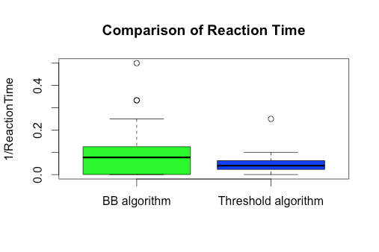
BB is reacting faster on average
Pattern: from lower density to higher density.
Select c from 100 values that uniformly in a range of (1,200).
Select w from 10 values that uniformly in a range of (1,100).
Select p from 10 values that uniformly in a range of (0.1,0.9).
Apply our “best guess” to 5 new data sets with 5 replications.

Slide 43
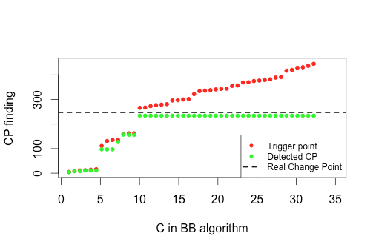
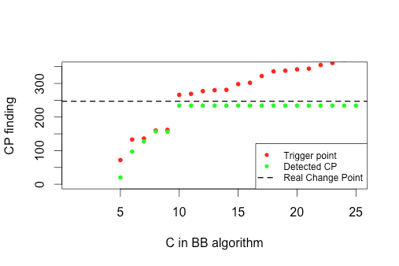
BB algorithm with two constant blocks
Example of how the c values affect the accuracy and time of detection
Notes:
[Stef]
To go into more detail about how the BB algorithm performs differently from thresholding, we’d like to share some results we got with simulated data that had two constant blocks. We preset the intensity function from y=50 change to y=100 at time of 5sec. For this specific simulated data, we know that the real change begins at the 247th point. Here, the Bayesian Block algorithm will correctly detect the change when the c value is equal to or bigger than 10. Before 10, the algorithm is too sensitive and incorrectly detects a changepoint in the noise. After 10, even the algorithm can “correctly” detect the change but the “reaction time” is longer as c goes bigger. So, ideally the best c is 10. (That is the smallest value of c when detected change point do not change)
With this best c value, the BB algorithm report trigger happens at 302, detected change point assumed to be 234.

Slide 44
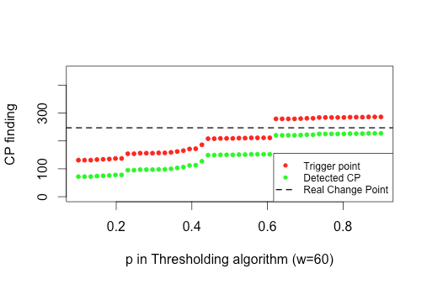
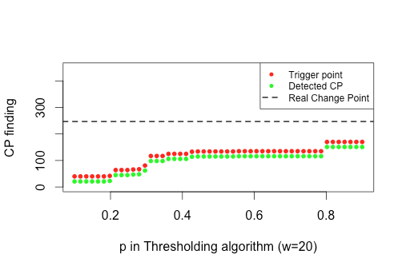
Thresholding algorithm with two constant blocks
Example of how the p and w values affect accuracy and time of detection
Notes:
[Stef]
Here is the same example, but with thresholding algorithm. Mark: the c in thresholding algorithm is different than the c in BB algorithm. It’s a decimal number which representing a percentage. As the plot showing here, when c set to be 0.4 or 0.5, the algorithm will do a good job. Before 0.4 the system will falsely report changes, and after 0.6 the system will detect nothing.
To compare with BB. When preset c to be 0.5, the thresholding algorithm would report trigger happens at 278 and assuming change point is 228.

Slide 45
Applications of Bayesian Block Triggering to Real Datasets
constant noise + constant signal (two constant blocks)
constant noise + linear signal (constant left block/ linear right block)
Real Gamma Ray Burst Data
Notes:
[Fangzhou]

Slide 46
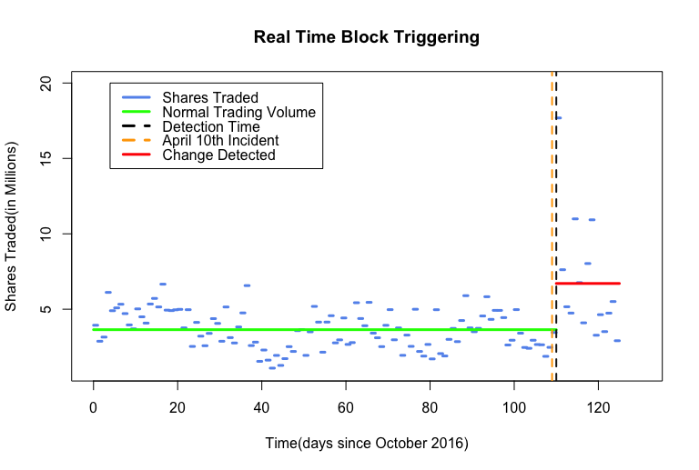
Constant Noise + Constant Signal
Dataset:
United Airlines, Inc. (UAL) daily historical volumes
(From 10/20/2016 to 5/15/2017)
Notes:
This dataset describe United Airlines, Inc. (UAL) daily historical volumes
April 10, Dr Dao was on his way home to Louisville from Chicago. And he was ordered off the plane to make room for United Airline staff. But when he refused, he was dragged off. This cause him to lose 2 teeth, and receiving a broken nose and a concussion. Of course, it’s a pretty bad publicity. And make UA stock become aggresive and high in portfolio risk. So share holder want to sell what they have and meanwhile, some agency bought it at low price. This is why the daily volume went up.
As We know the fact, we konw there is real change point occurs. we want to apply the BB algo to it and see the performance.
Data is from 10/20/2016 to May 15 2017
At previous days, the volume do not show a lot flatuation..as ua is a steady and growing company
And the orange dot line is April 10
And we can see big jump here, BB algo detect the change point and regard the data after Arpril 10 as a new block.
So we can apply this to real stock market to detect peaks and troughs

Slide 47
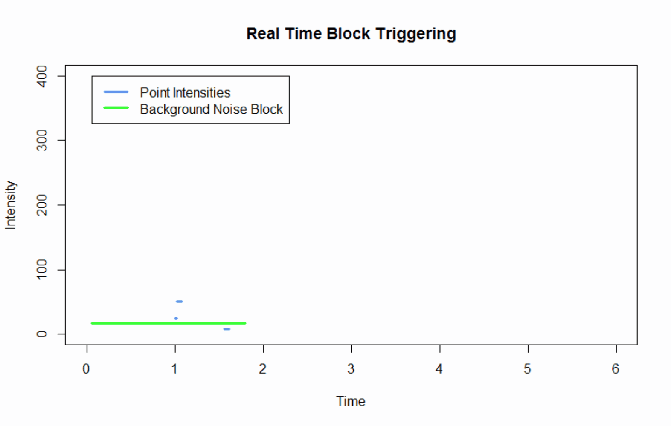
Constant Noise + Linear Signal
Dataset: Synchronized Brainwave Recordings with a Audio-Visual Stimulus
(from UC Berkeley)
Focus on: the timestamp each Neuron signal received
Notes:
The data is from one UC Berkeley study, the Synchronized Brainwave Recordings with an Audio-Visual Stimulus. The researcher showed some videos to a group of students and record student's brain activities. The plot here shows the brainwave signal frequency for one of the students. At first, the braiwave signal frequency remained flat at a low level. Then the student became interested in the stimulus, and brain activity increased linearly. The Bayesian Block algorithm can capture that linear change.

Slide 48
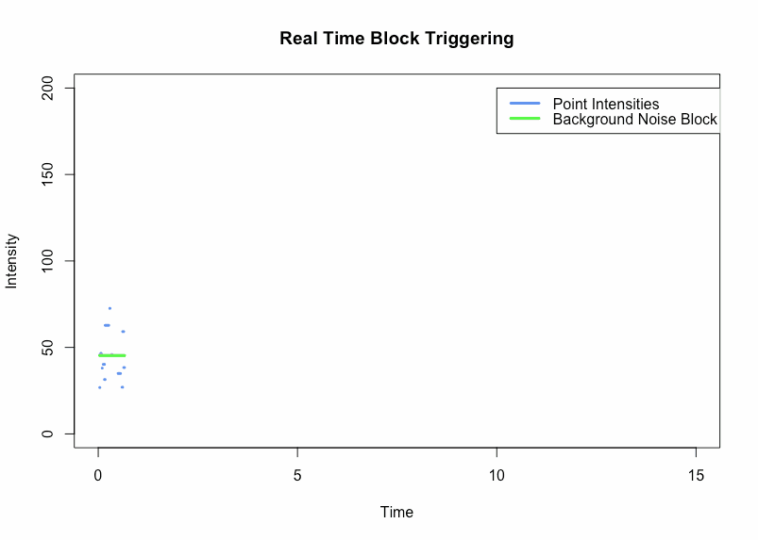
Real Gamma Ray Burst (GRB) Data
Notes:
From the previous slides, we know that the intensity increases dramatically when a gamma ray burst signal is detected.
We can see the green line here, the BB algorithm detecting the noise as one constant block.
Then once the first intensity peak occurs, at around the 4th decisecond here, the BB algorithm determines that the optimal partition would have the new data in a new block.
And we can see the red line here, the second block is a linear block.
That’s all of our presentation, thank you for your listening!

Slide 49
Thanks for listening!
Any questions?

Slide 50
APPENDIX

Slide 51

Is this test valid?

Slide 52

Is this test valid?

Slide 53

Compare BB and Threshold by “Target rate”
Target rate =
the number of parameters that result in the trigger occurring after the true CP, AND the estimated CP lying before the true CP
the number of parameters in a big range
BB algorithm:
Uniformly select 400 values of c from 1 to 100.
⇒ Target rate = 0.96
Threshold algorithm:
Uniformly select 20 values of p from 0.1 to 0.9, and 20 values of w from 1 to 200.
⇒ Target rate = 0.345
Notes:
As Stef. has showed in the previous slides, we know that the parameters (c in BB, p,w in Threshold) has significant effect on the result. So, how well the parameters will The result is suggesting that, when the experimenter has no knowledge about the datasets, run BB algorithm will has 96% chance to well locate the true change point. Whereas by running Threshold algorithm, only has 34.5% chance to locate the real change point. So, BB algorithm more robust than Threshold.

Slide 54

Thresholding algorithm with two constant blocks
How windows size affect the algorithm
(size)

Slide 55


Accuracy
Average of 20 runs for each C/P value
Window size = 50
Notes:
[Jiaxing]
For now, we’d like to share some results we got with simulated data that had two constant blocks. We preset the intensity function from y=50 change to y=100 at time of 5sec. For this specific simulated data, we know that the real change happens by adding the 247th point in.
Here, the Bayesian Block algorithm will correctly response the change when setting the c value bigger than 10. Before 10 the algorithm seems too sensitive and keep reporting something that “suspicious”. After 10, even the algorithm can “correctly” response the change but the “reaction time” is longer as c goes bigger. So, ideally the best c is 10. (That is the smallest value of c when detected change point do not change)
With this best c value, the BB algorithm report trigger happens at 302, detected change point assumed to be 234.

Slide 56


Reaction Time

Slide 57


Window...

Slide 58

Compare BB and Threshold by Accuracy
Use those “best guess” of parameters in each algorithm, test other 20 simulated datasets which holds same pattern.

Slide 59

Compare BB and Threshold by Reaction Time
Notes:
Should we evaluate those two metrics numerically? How to handle negative values?

Slide 60
Data sources
Energy data: http://www.economagic.com/doeme.htm
traffic data source https://data.wprdc.org/terms-of-use?came_from=%2Fdataset%2Fallegheny-county-traffic-counts

Slide 61

Future Work
Allow any user-supplied shape functions
Force continuity between each piecewise shape
Analyze more real GRB data
Try other model comparison methods

